Slide 2

Servants
that become
our Masters

Slide 3
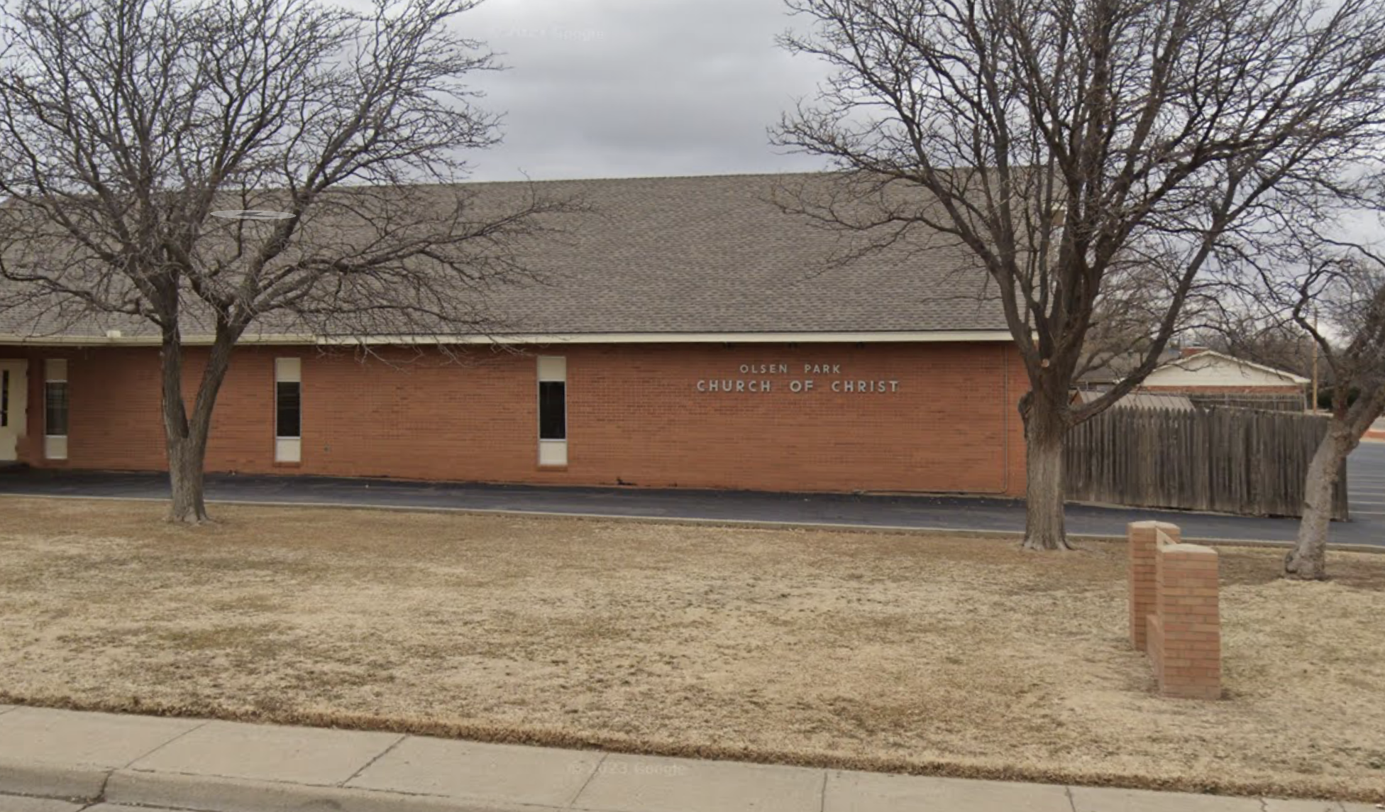
The Meeting Place
“Church” signs

Slide 4
The Meeting Place
“Church” signs
Church = People
Master indicators

Slide 5
Leaders
Every church has leadership
Elders/Pastors/Overseers

Slide 6
Christ
Elders
Deacons
Saints

Slide 7
Christ
Saints
Deacons
Elders

Slide 8
Leaders
Every church has leadership
Elders/Pastors/Overseers
Preachers/Evangelists

Slide 9
Family
Beautiful gifts
Should serve to help us
But become our masters

Slide 10
Servants
that become
our Masters

